Slide 1
SQL WORKSHOP
Association of Data Science

Slide 2
WHAT is sql?
SQL: Structured Query Language
Used to communicate with databases
Common tasks
Retrieve data
Insert new data
Update or delete records
Analyze data sets
Widely used in data science analytics, and software development

Slide 3
DATABASES Examples
Social media feeds
Online shopping catalogs
Banking systems
University course registration

Slide 4
Our tables
people table
name | age | occupation | college
John Peterson | 34 | Marketing director | UNC
Emily Johnson | 27 | Data scientist | UNC Charlotte
James Smith | 25 | Civil engineer | NC A&T
Jenna Shaw | 36 | Data scientist | UNC Charlotte
Diego Williams | 24 | Entrepreneur | NC State

Slide 5
Our tables
college table
college | city | state
UNC | Chapel Hill | NC
UNC Charlotte | Charlotte | NC
NC A&T | Greensboro | NC
Duke University | Durham | NC

Slide 6
BASIC SQL SYNTax
SELECT → What you want
FROM → Where it’s stored
WHERE → filter results
ORDER BY → sort results
SELECT column1, column2
FROM table_name
WHERE condition
ORDER BY column1;

Slide 7
SELECT + FROM
Returns all rows, showing name and age columns
“Show me all the name and age columns in this table”
SELECT name, age
FROM people;
name | age
John Peterson | 34
Emily Johnson | 27
James Smith | 25
Jenna Shaw | 36
Diego Williams | 24

Slide 8
SELECT & FROM
Returns all rows, showing all columns
“Show me all the columns in this table”
SELECT *
FROM people;
name | age | occupation | college
John Peterson | 34 | Marketing director | UNC
Emily Johnson | 27 | Data scientist | UNC Charlotte
James Smith | 25 | Civil engineer | NC A&T
Jenna Shaw | 36 | Data scientist | UNC Charlotte
Diego Williams | 24 | Entrepreneur | NC State

Slide 9
WHERE
Comparison operators: =, >, <, >=, <=, !=
Text comparison use quotes: WHERE college = ‘UNC Charlotte’
SELECT *
FROM people;
WHERE age > 30;
name | age | occupation | college
John Peterson | 34 | Marketing director | UNC
Jenna Shaw | 36 | Data scientist | UNC Charlotte

Slide 10
ORDER BY
ASC = ascending (default)
DESC = descending
SELECT *
FROM people;
ORDER BY age DESC;
name | age | occupation | college
Jenna Shaw | 36 | Data scientist | UNC Charlotte
John Peterson | 34 | Marketing director | UNC
Emily Johnson | 27 | Data scientist | UNC Charlotte
….

Slide 11
ALIASes & LIMIT
AS renames columns in the result
LIMIT shows only a certain number of rows
SELECT name AS employee, age
FROM people;
LIMIT 2;
name | age
John Peterson | 34
Emily Johnson | 27

Slide 12
Aggregation functions
COUNT() → number of rows
SUM() → calculates sum of all non-NULL values
AVG() → average of all non-NULL values
MAX() →highest values
MIN() → lowest values
SELECT AVG(age)
FROM people;
Returns:29.2

Slide 13
GROUP BY & HAVING
Group by → groups rows with the same values
Having → filters groups (after aggregation)
SELECT occupation, COUNT(*) AS num_people
FROM people;
GROUP BY occupation
HAVING COUNT(*) > 1;
occupation | num_people
Data scientist | 2

Slide 14
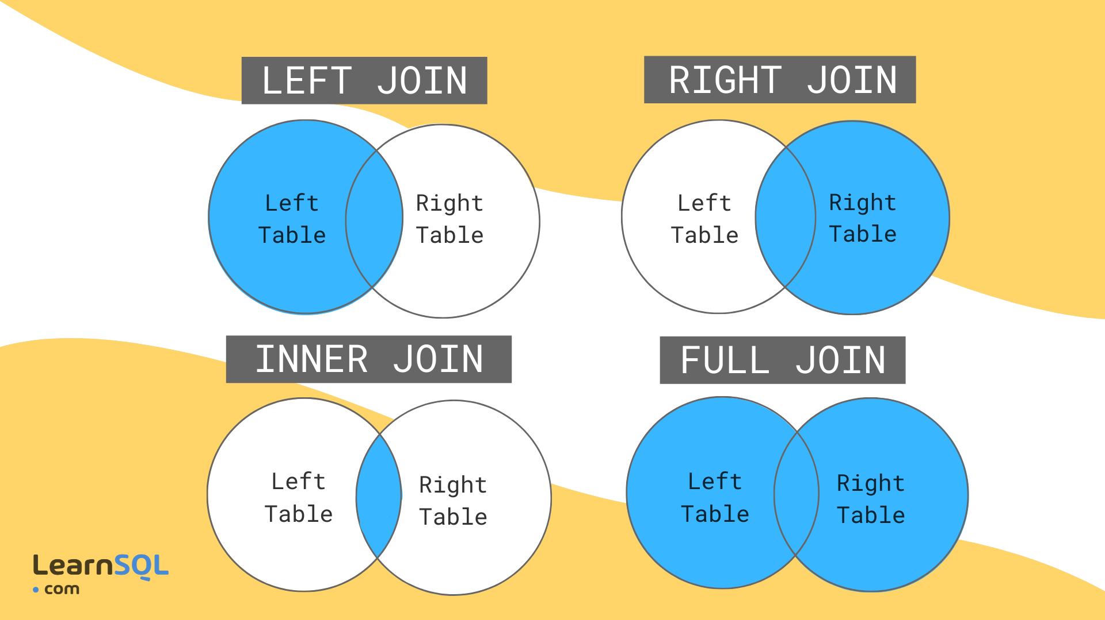
JOINs

Slide 15
INNER JOIN
SELECT p.name, c.college, c.city
FROM people p;
INNER JOIN colleges c
ON p.college = c.college;
name | college | city
John Peterson | UNC | Chapel Hill
Emily Johnson | UNC Charlotte | Charlotte
James Smith | NC A&T | Greensboro
Jenna Shaw | UNC Charlotte | Charlotte

Slide 16
LEFT JOIN
SELECT p.name, c.college, c.city
FROM people p;
LEFT JOIN colleges c
ON p.college = c.college;
name | college | city
John Peterson | UNC | Chapel Hill
Emily Johnson | UNC Charlotte | Charlotte
James Smith | NC A&T | Greensboro
Jenna Shaw | UNC Charlotte | Charlotte
Diego Williams | NC state | NULL

Slide 17
RIGHT JOIN
SELECT p.name, c.college, c.city
FROM people p;
RIGHT JOIN colleges c
ON p.college = c.college;
name | college | city
John Peterson | UNC | Chapel Hill
Emily Johnson | UNC Charlotte | Charlotte
James Smith | NC A&T | Greensboro
Jenna Shaw | UNC Charlotte | Charlotte
NULL | Duke University | Durham
Note, right joins are not very commonly used and can be converted to left joins

Slide 18
FULL OUTER JOIN
SELECT p.name, c.college, c.city
FROM people p;
FULL OUTER JOIN colleges c
ON p.college = c.college;
name | college | city
John Peterson | UNC | Chapel Hill
Emily Johnson | UNC Charlotte | Charlotte
James Smith | NC A&T | Greensboro
Jenna Shaw | UNC Charlotte | Charlotte
Diego Williams | NC state | NULL
NULL | Duke University | Durham

Slide 19
Practice
We’ll practice our skills using SQL Island! (https://sql-island.informatik.uni-kl.de/)

Slide 20
WRAP UP
Today we covered
What SQL is
How to write basic queries
How to filter, sort, group, and join data
Applying what we learned to a real database
Next Steps
Escape SQL Island
Try out online SQL sandboxes (SQL Island has one)

